Slide 1
SATs 2026
Parent Meeting 26.01.26

Slide 2
Assessment and Reporting
‘Old’ national curriculum levels (e.g. Level 3, 4, 5) have been abolished, as set out in the government guidelines.
Test scores are now reported as ‘scaled scores’.

Slide 3
Scaled Scores
100 represents the ‘national standard’.
Each pupil’s raw test score will therefore be converted into a score on the scale, either at, above or below 100.
The scale ranges from 80 to 120.
A scaled score of 80 – 99 means the child has not reached the required standard
A scaled score of 100 or above means the child has reached the required standard.
A scaled score of 110 – 120 means the child is working at greater depth in that area.

Slide 4
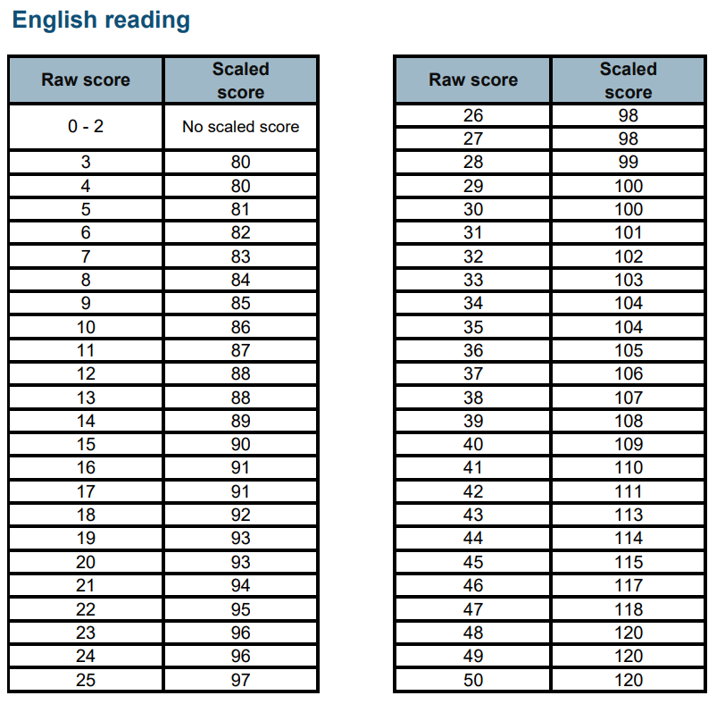
Scaled score example

Slide 5
Test Week!
Monday 11th May – English grammar and punctuation (paper 1) spelling (paper 2)
Tuesday 12th May – Reading paper
Wednesday 13th May – Maths arithmetic (paper 1) Maths reasoning (paper 2)
Thursday 14th May – Maths reasoning (paper 3)
All tests are externally marked.
Writing will be ‘Teacher Assessed’ internally, as in recent years.

Slide 6
Spelling, Punctuation and Grammar
A Spelling test is administered containing 20 words, lasting approximately 15 minutes.
A separate test is given on punctuation, vocabulary and grammar
This test lasts for 45 minutes and requires short answer questions, including some multiple choice.
Marks for these two tests are added together to give a total for Spelling, Punctuation and Grammar.

Slide 7
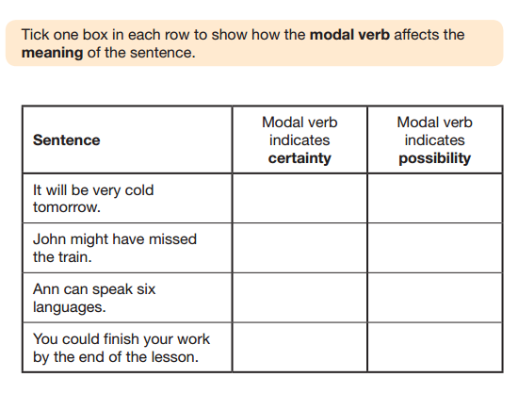
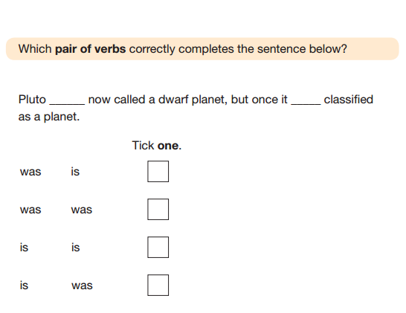
Sample SPAG questions

Slide 8
Reading
The Reading Test consists of a single test paper with three unrelated reading texts.
Children are given 60 minutes in total, which includes reading the texts and answering the questions.
A total of 50 marks are available.
Questions are designed to assess the comprehension and understanding of a child’s reading.
Some questions are multiple choice or selected response, others require short answers and some require an extended response or explanation.

Slide 9
Maths
Children will sit three tests: Paper 1, Paper 2 and Paper 3.
Paper 1 is ‘Arithmetic’ lasting for 30 minutes, covering calculation methods for all operations, including use of fractions, percentages and decimals.
Papers 2 and 3 cover ‘Problem Solving and Reasoning’, each lasting for 40 minutes.
Pupils will still require calculation skills but will need to answer questions in context and decide what is required to find a solution.

Slide 10
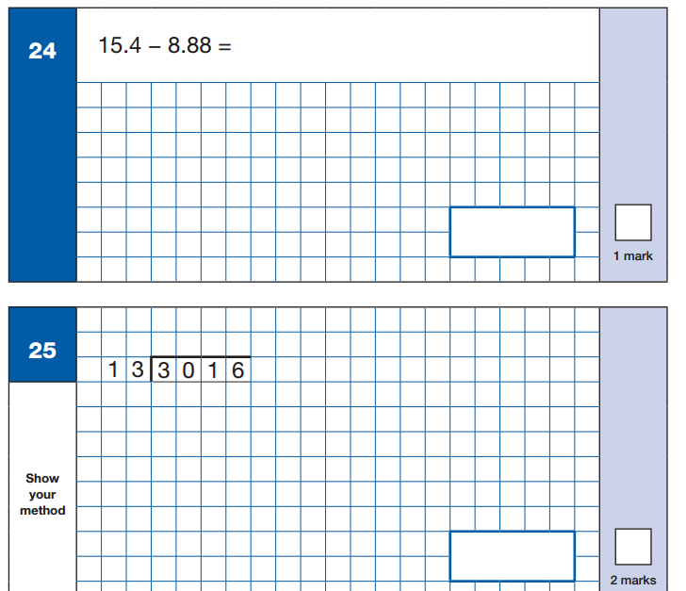
Arithmetic example

Slide 11
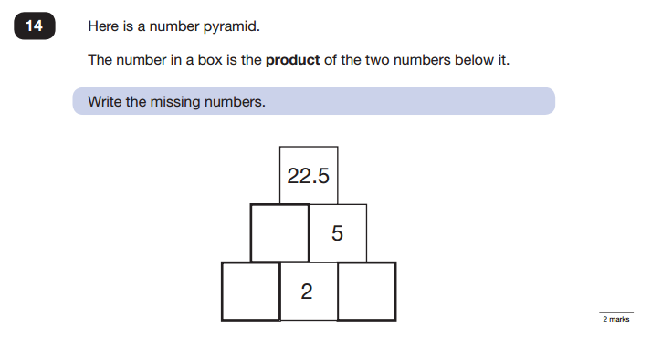
Reasoning example

Slide 12
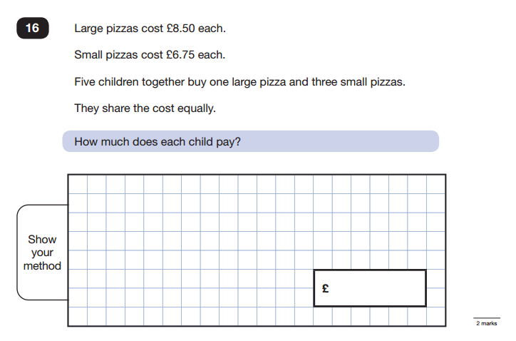
Reasoning example

Slide 13
Writing assessments
Children’s writing will be teacher assessed in school.
We look at a range of writing in the children’s books to find examples of the features required.
Raw scored is not used to assess writing

Slide 14
How to help your child…
First and foremost, support and reassure your child that there is nothing to worry about and they should always just try their best. Praise and encourage!
Ensure your child has the best possible attendance at school.
Reading and arithmetic (e.g. times tables) are always good to practise.
Talk to your child about what they have learnt at school and what book(s) they are reading (the character, the plot, their opinion).
No holidays in term time or the week of SATs.
Good nights sleep the night before.

Slide 15
How we will help your child…
Children will be made familiar with the types of questions and tests they will be sitting throughout Spring and Summer terms. They also looked at some of these in Autumn term.
‘Do now’ tasks – morning and afternoon – punctuality is crucial in order for your child to access these tasks!
Mock weeks – week beginning 9th February and week beginning 13th April

Slide 16
Accessibility arrangements
Some children may have additional support through one of the following means:
Additional time, someone to read questions to them or a scribe
This is applied for in school based on a variety of evidence and if accepted we receive confirmation telling us which means of support a child is allowed access to.
We use a variety of rooms to complete SATs but all are rooms that the children are familiar with.
These arrangements are all applied to MOCK tests too so that the children are familiar with the process.

Slide 17
SATs Revision Guides
We have SATS revision guides for you to take away today. One for Maths and one for English.
We ask that these do not get written in so that we can use them in future years.
We will ask for them back the week after SATS and we will charge £5 if the books are not returned.
Please do not feel like you have to make your children work through lots of pages at once! Little and often will be the best approach with these revision guides.
Please sign for these at the end of the next session with the children

Slide 18
Workshop

